Slide 1
COMP 1537
The Document Object Model (DOM)
& Events

Slide 2
What is the Document Object Model?
The DOM is the data representation within the runtime environment that represents HTML structure
Where structure could be:
An entire HTML document (including, but not limited to the current loaded document)
HTML snippets that are in-memory
The W3C DOM:
Has a specified set of programming calls
Referred to as an Application Programming Interface (API)
Has programming language bindings for Java, PHP, C#, C++, ECMA Script (so JavaScript, ActionScript)
A model driven parser (tree based)
Reads the entire XML (HTML in our case) document into memory
And load the XML elements, attributes, comments, namespaces, etc., into memory
Where each element item is an in-memory object
This creates an in-memory hierarchical representation of the document

Slide 3
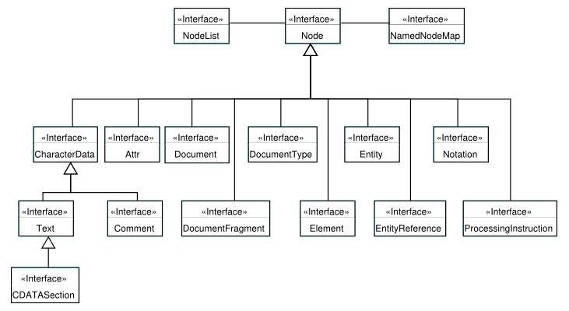
DOM Concepts (1/4)
Different things in a page are represented by different data structures
But all objects in the DOM are of type node; node is like the Object class in Java
Node is the super type of the following:

Slide 4
DOM Concepts (2/4)
The DOM treats every item in an XML (HTML too) document as a node (this is the super type)
The node super type has several sub types:
Elements, text, PI, namespace, document, comment, entity, attribute, and a few others
Each of the node types is represented in memory using programming language objects
Allowing the manipulation (add/edit/delete) of each type in a concise & consistent manner
NodeList is the type returned when asking for a node's child nodes (could be elements, text, etc.)
The NodeList object is a collection of child nodes
List of types for DOM
So, how does the W3C DOM see an XML/HTML document?

Slide 5
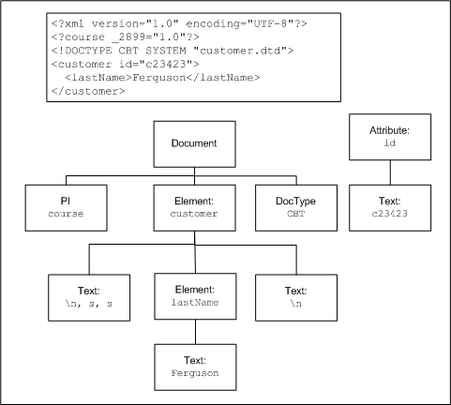
DOM Concepts (3/4)
A few things to note:
Document is a node (and a subtype of the node data type)
The document node has 3 child nodes: PI, DOCTYPE, and the root element
The XML declaration does not show up as a child node of the document node (but PIs, DOCTYPE declarations do)
Strings of continuous text are considered nodes too
Even tabs, new lines and space are considered “textual data” and are considered nodes
As how the previous diagram demonstrates
With the exception being the root of the document
Parsers usually ignore the text nodes before the root element
Notice the newline between the PI and DOCTYPE
And the newline between the DOCTYPE and root element?

Slide 6
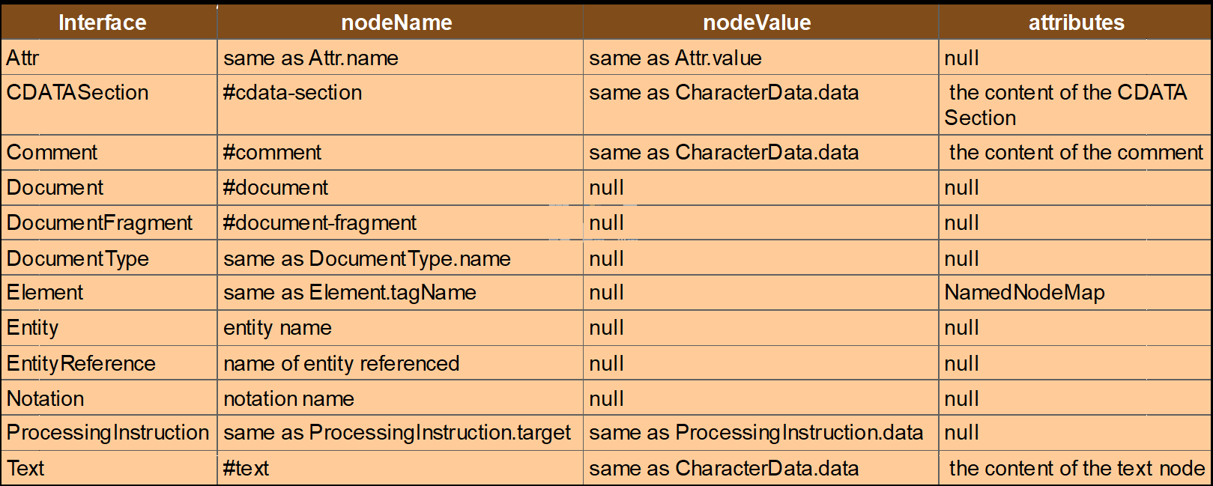
DOM Concepts (4/4)
Attributes are not considered “child nodes” of the their surrounding element
They are considered “properties” of the element they are contained within
Attributes do have text nodes
Or rather they have a text node
Since only one the API call doesn't require a call to child nodes

Slide 7
Creating elements & attributes
The document (which is of type document) object has many properties and many methods as well (see DOM-creating.html)
Some properties that are commonly used:
body, forms, images, links, scripts
Some methods that are commonly used:
createTextNode(), getElementById(), createAttribute(), getElementsByClassName(), getElementsByName(), getElementsByTagName(), querySelector(), querySelectorAll(), appendChild(), setAttribute(), replaceChild(), createElement() – to name a few!
Can also programmatically add style too (see DOM-styling-programmatically.html)
And very important to traverse/find elements (see DOM-traversing.html)

Slide 8
DOM Summary
With JavaScript, we can:
Create new elements, style elements, add attributes, change attributes
Use CSS selectors to select elements and sub-trees
You can replace certain parts of a document with newly created content
You’ll be doing this for your next assignment
Look at DOM examples now …

Slide 9
Intro to DOM Events
Events are 'things' that happen
E.g., page loaded, user clicked on a button,
E.g., user dragged an icon onto a div
E.g., user moused over a form, video finished playing
Events in JavaScript are generated by the JavaScript runtime
And are represented by event objects
E.g., MouseEvent, KeyEvent
Each of these types of events has properties and methods that can be called

Slide 10
Types of DOM Events
There are event types for various different things that happen
Mouse events – mouse click, mouse over, etc.
Key events – key pressed, key down, key up, etc.
Window events – page finished loading, etc.
Form events – user attempted to submit, etc.
Clipboard events – user copied/pasted, etc.
Media events – media data is loaded, etc.
For more on each of the event types, see:
https://developer.mozilla.org/en-US/docs/Web/Events

Slide 11
Responding to events (1/3)
How to respond to events?
Use event listeners – listeners are almost identical to callbacks
Listeners are specific to UI runtimes
Event listeners are objects that respond to a certain type of event
You create an event listener method that catches the event
And (hopefully) does something meaningful as a response
Event listener methods:
addEventListener, removeEventListener

Slide 12
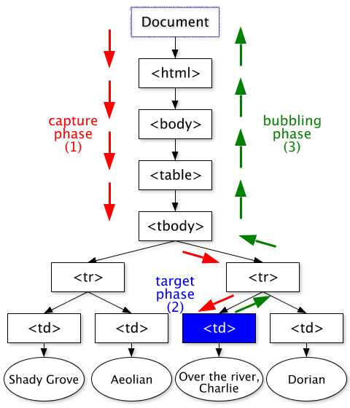
Responding to events (2/3)
Element addEventListener:
Where:
Element is a DOM element (e.g., div)
Event is an event (e.g., click)
Function is a defined function, could be a(n):
Anonymous function expression
Function declaration
useCapture: true or false
Capture is at the beginning of the event
Bubble is at the end of the event
element.addEventListener(event, function,
useCapture);

Slide 13
Responding to events (3/3)
Which objects do you use to capture events?
Any DOM element
The window object (which represents a tab in the browser)
Look at DOM event examples now …
document.getElementById("p1").addEventListener("click",
function(event) { console.log("…"); },false);
window.addEventListener("load", function(event) { console.log("…"); }, false);

Slide 14
Resources (1/1)
https://developer.mozilla.org/en-US/docs/Web/API/Document_Object_Model/Introduction
https://developer.mozilla.org/en-US/docs/Web/API/Document_object_model
https://developer.mozilla.org/en-US/docs/Learn/JavaScript/Building_blocks/Events
https://developer.mozilla.org/en-US/docs/Web/Events
https://developer.mozilla.org/en-US/docs/Web/API/EventTarget/addEventListener
https://www.w3.org/TR/2003/NOTE-DOM-Level-3-Events-20031107/events.html#Events-phases

